Slide 1

Exploratory Data Analysis
G2M Insight for Cab Investment Firm
March, 2024

Slide 2

Agenda
Executive Summary
Problem Statement
Approach
EDA
EDA Summary
Recommendations

Slide 3
Executive Summary
Profitability Trends: The analysis reveals distinct patterns in the profitability of Pink Cab and Yellow Cab companies. However, Yellow Cab outperforms Pink Cab across all metrics. Both companies exhibit higher profits in December, January, February, March, and April, but while Yellow Cab peaks in May, Pink Cab has the least profit.
Geographical Variations: Profits seem to vary significantly based on location, with certain cities such as New York and Silicon Valley yielding higher profits than others. Moreover, while Yellow Cab had considerably high profits in Dallas, Pink Cab had little profit.

Slide 4
Problem Statement
The G2M Insight for Cab Investment Firm project aims to provide valuable insights and recommendations for a cab investment firm by analyzing data related to cab services, customer demographics, and financial performance of two cab companies: Yellow Cab and Pink Cab. The project involves data exploration, hypothesis testing, and model building to support strategic decision-making.

Slide 5
Approach
The G2M Insight for Cab Investment Firm project aims to provide valuable insights and recommendations for a cab investment firm by analyzing data related to cab services, customer demographics, and financial performance of two cab companies: Yellow Cab and Pink Cab. The project involves data exploration, hypothesis testing, and model building to support strategic decision-making.

Slide 6
Exploratory Data Analysis
Univariate Analysis
Distribution of numerical columns such as KM Travelled, Cost of Trip, Age, Profit on Trip, Profit per KM, and Income (USD/Month) is analyzed for both Yellow Cab and Pink Cab companies.
Bar charts are used to visualize key performance indicators (KPIs) by company, year, month, day of the week, and city.

Slide 7
Exploratory Data Analysis
Bivariate Analysis
Scatter plots are used to explore relationships between variables such as Profit on Trip vs. Kilometer Travelled, Profit on Trip vs. Price Charged, and Profit on Trip vs. Cost of Trip.

Slide 8
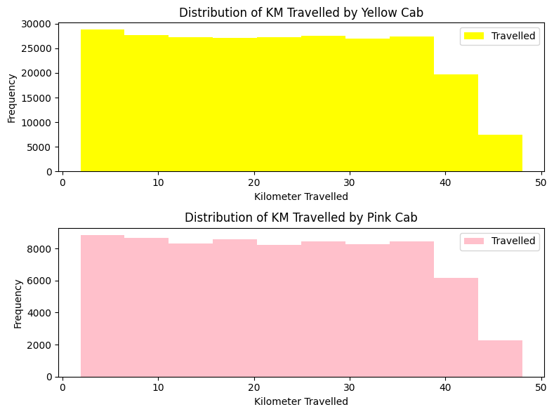
Distribution of Distance Travelled
Most of the distance covered on each trip by the Yellow Cab and Pink Cab is between two (2) and forty-three (43) kilometers. Moreover, Yellow Cab enjoys more patronage than Pink Cab

Slide 9
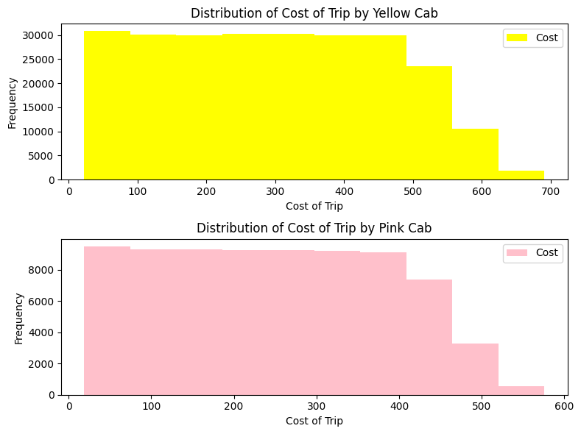
Distribution of Cost of Trip
Most of the distance covered on each trip by the Yellow Cab and Pink Cab is between two (2) and forty-three (43) kilometers. Moreover, Yellow Cab enjoys more patronage than Pink Cab

Slide 10
Distribution of Customers’ Age
Most of Cab customers are aged between twenty (20) and forty years old however, Yellow Cab enjoys more patronage that Pink Cab.

Slide 11
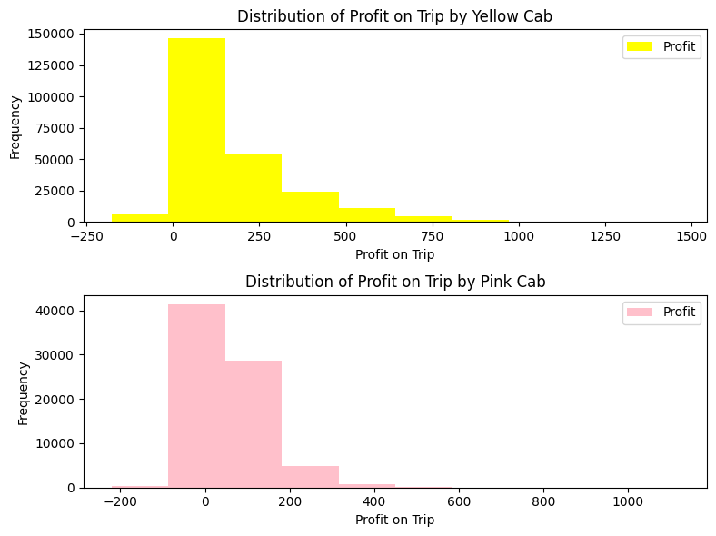
Distribution of Profit Made
Yellow Cab made most profit between zero ($0) and two-hundred ($200) and some losses on each trip. Pink Cab inquired high losses and its most profit is between zero dollars ($0) and two-hundred dollars ($200). Overall Yellow Cab is more profitable than Pink Cab.

Slide 12
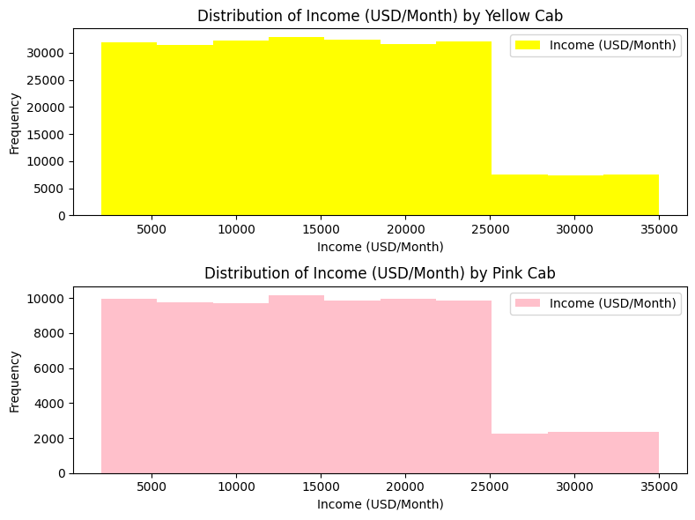
Distribution of Customers’ Income (USD/Month)
Most customers earn between two-thousand ($2000) and twenty-five-thousand ($25,000) monthly. Yellow Cab enjoys more patronage than Pink Cab.

Slide 13
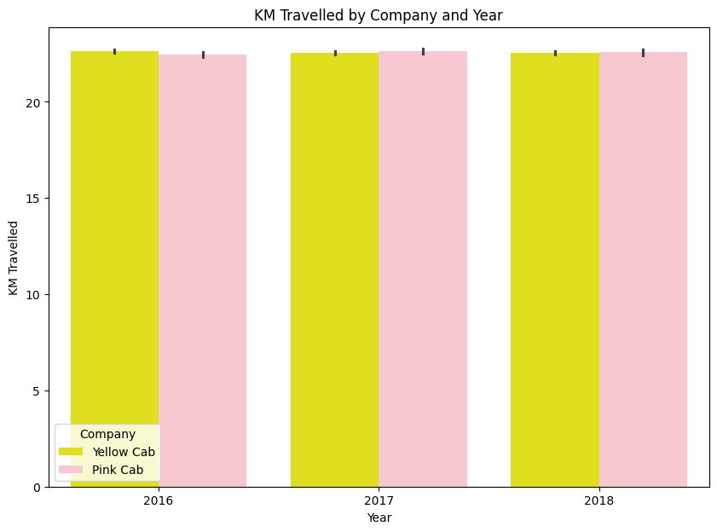
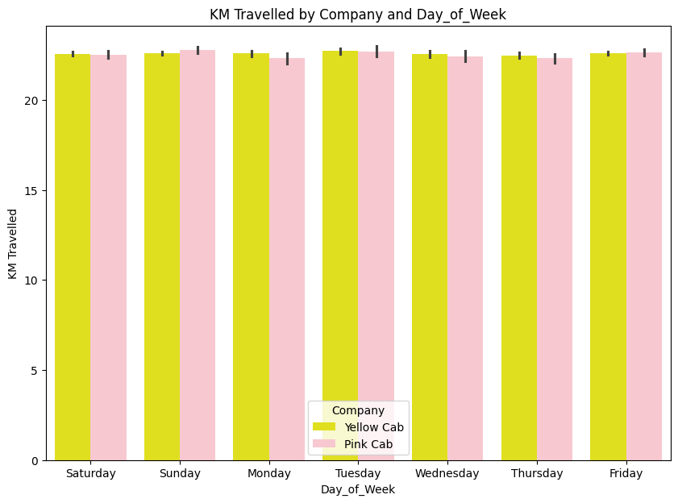
Analysis of Distance Travelled
There seems to be no difference in the distance on each trip by both Yellow Cab and Pink Cab in both 2016, 2017 and 2018.
There seems to be no difference in the distance on each trip by both Yellow Cab and Pink Cab in the days of the week.

Slide 14
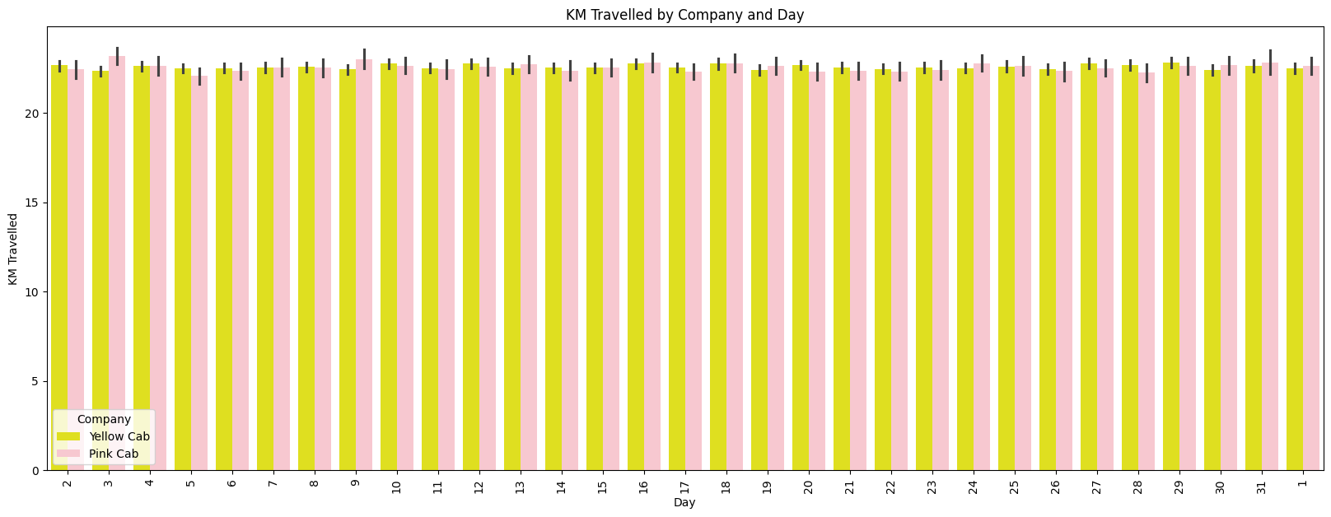
Analysis of Distance Travelled
There seems to be no difference in the distance on each trip by both Yellow Cab and Pink Cab in the 31 days in the month.

Slide 15
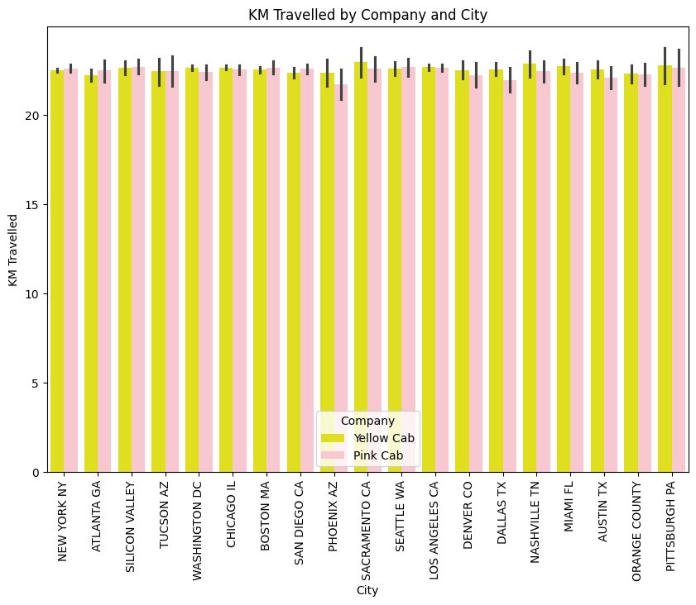
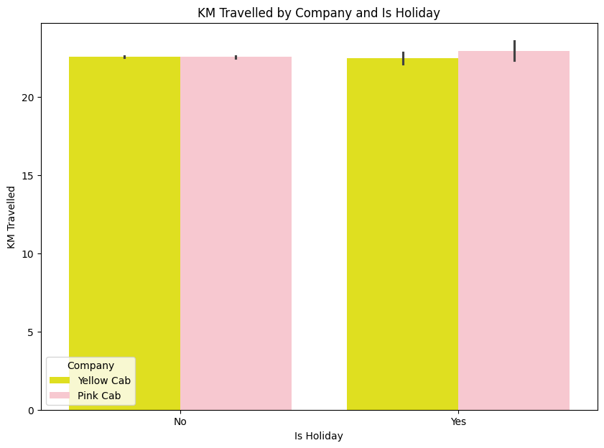
Analysis of Distance Travelled
There seems to be no difference in the distance on each trip by both Yellow Cab and Pink Cab across the cities.
There seems to be no difference in the distance on each trip by both Yellow Cab and Pink Cab on both when there is a holiday and not.

Slide 16
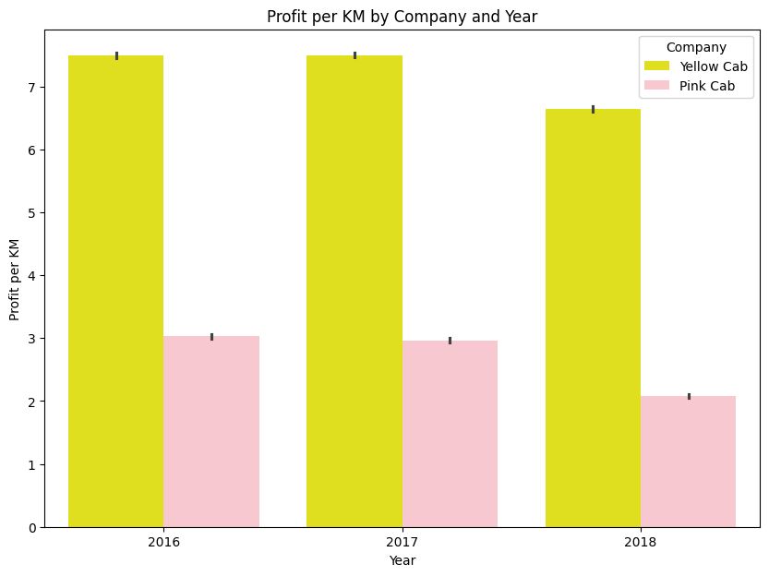
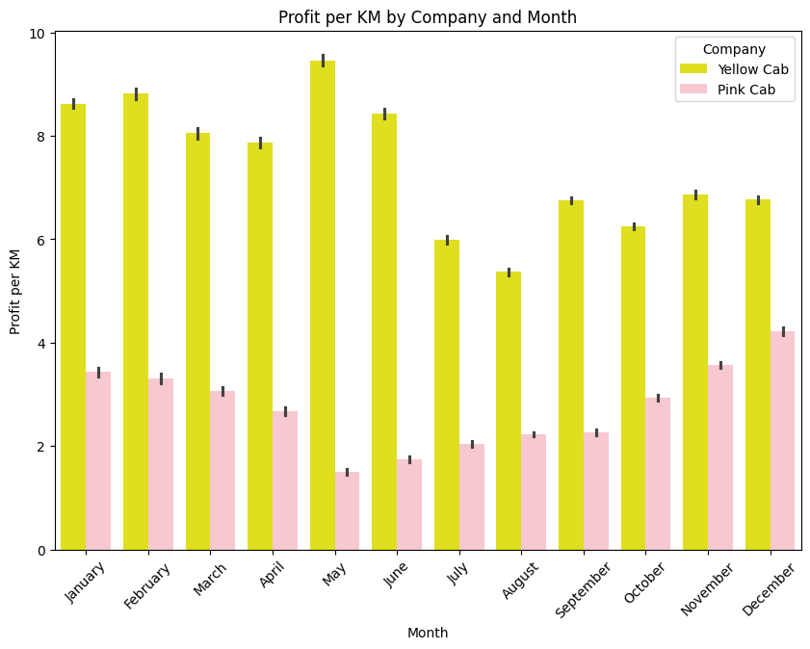
Analysis of Profit per Kilometer Travelled
Yellow Cab makes more than double the profit made by Pink Cab makes on each kilometer cover.
Yellow Cab makes a lot more profit than Pink Cab makes on each kilometer covered every month and in the Month of May and June Pink Cab made extremely low profit while Yellow Cab had the highest profit in those months.

Slide 17
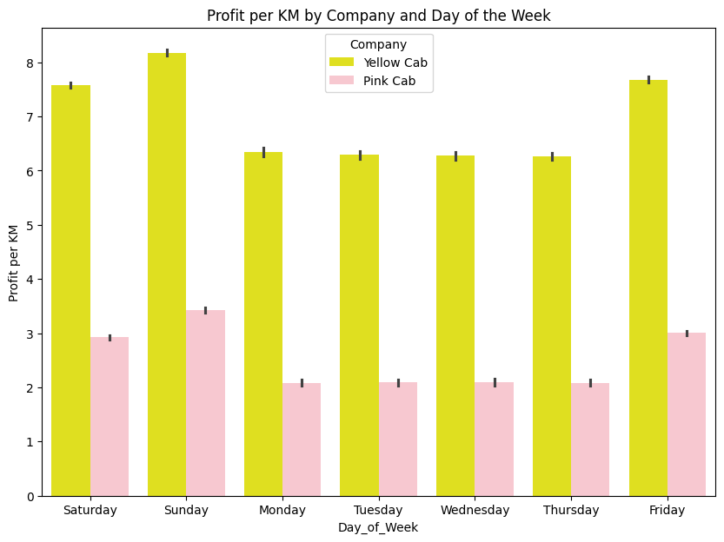
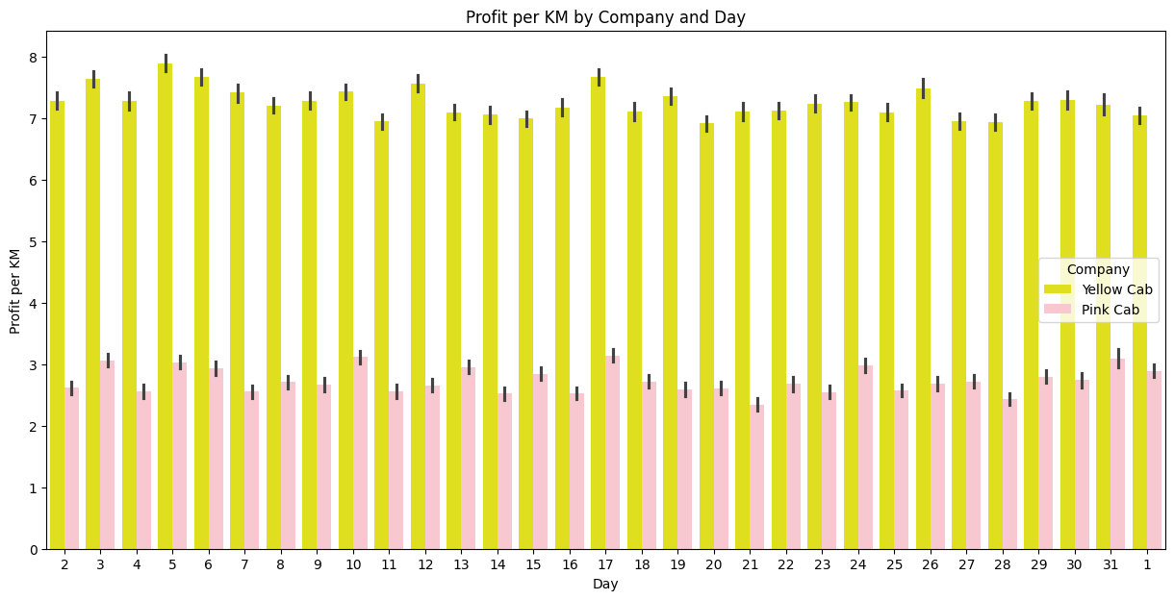
Analysis of Profit per Kilometer Travelled
Yellow Cab makes a lot more profit than Pink Cab makes on each kilometer covered every day of the week and they both had their highest profit on Fridays and Sundays.
Yellow Cab makes a lot more profit than Pink Cab makes on each kilometer covered every day of the month.

Slide 18
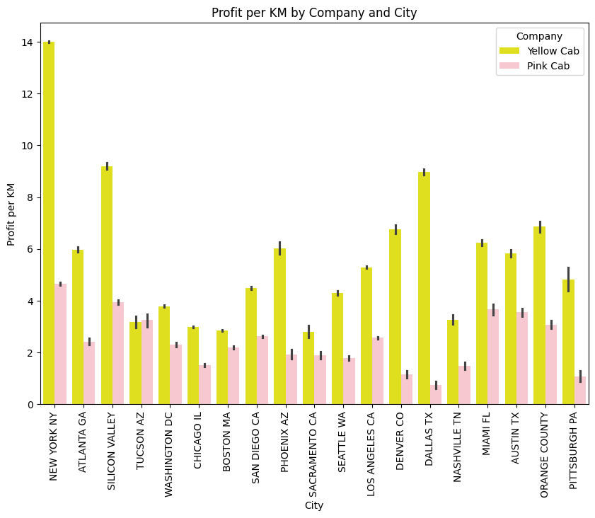
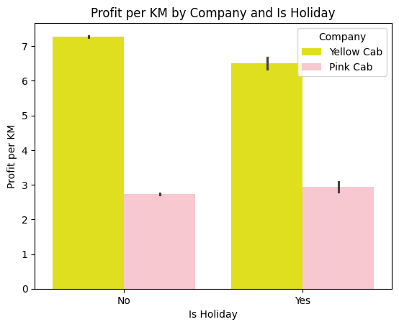
Analysis of Profit per Kilometer Travelled
Yellow Cab makes a lot more profit than Pink Cab makes on each kilometer covered in every city. Yellow Cab makes the highest profit in New York, Silicone Valley and Dallas while Pink Cab makes very low profit in Dallas, Denver and Pittsburgh.
Yellow Cab makes more profit both on when holiday and not. There seems to be no significance difference in patronage between when there is holiday or not.

Slide 19
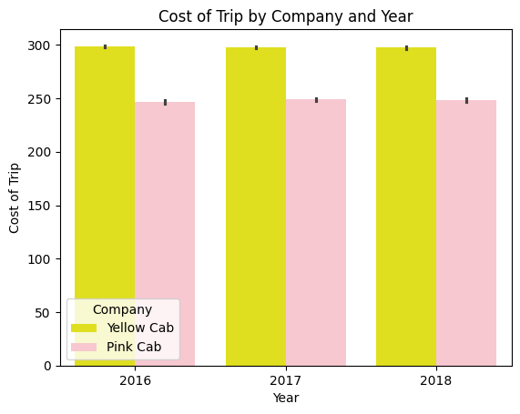
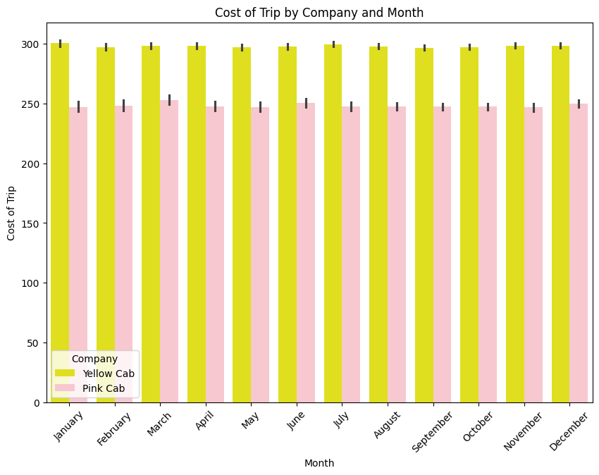
Analysis of Cost per Trip
The cost of trip by Yellow Cab is slightly higher than the cost of trip by Pink Cab across the 3 years.
The cost of trip by Yellow Cab is slightly higher than cost of trip by Pink Cab.

Slide 20
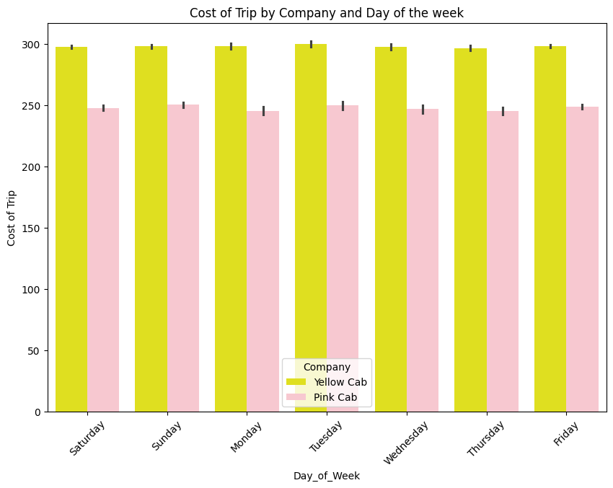
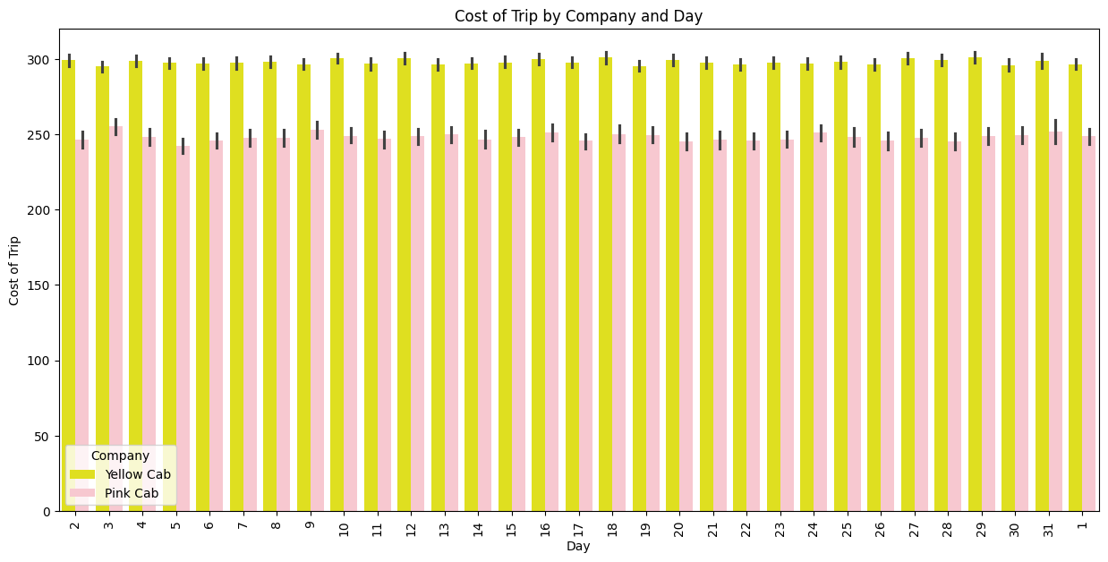
Analysis of Cost per Trip
The cost of trip by Yellow Cab is slightly higher than cost of trip by Pink Cab.
The cost of trip by Yellow Cab is slightly higher than cost of trip by Pink Cab.

Slide 21
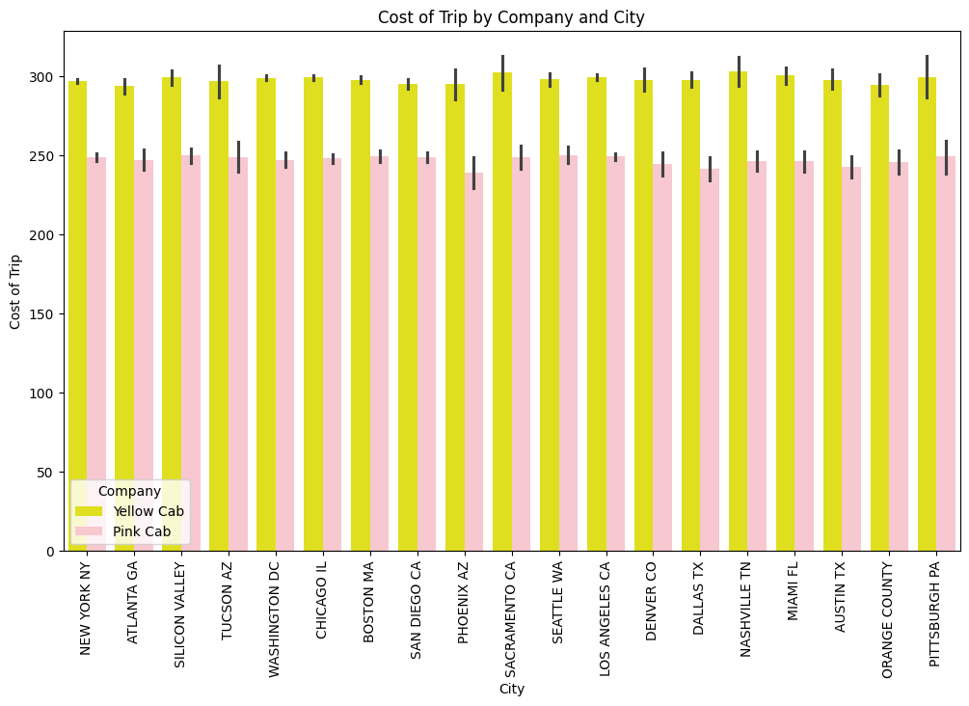
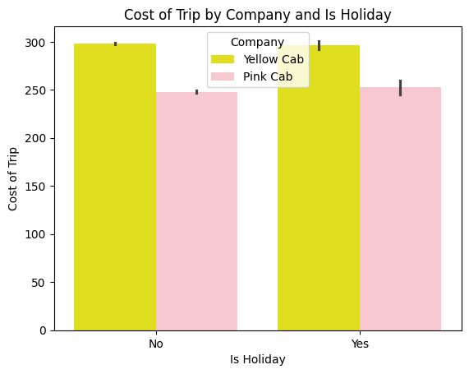
Analysis of Cost per Trip
The cost of trip by Yellow Cab is slightly higher than cost of trip by Pink Cab on both when there is holiday or not.
The cost of trip by Yellow Cab is slightly higher than cost of trip by Pink Cab in all the cities.

Slide 22
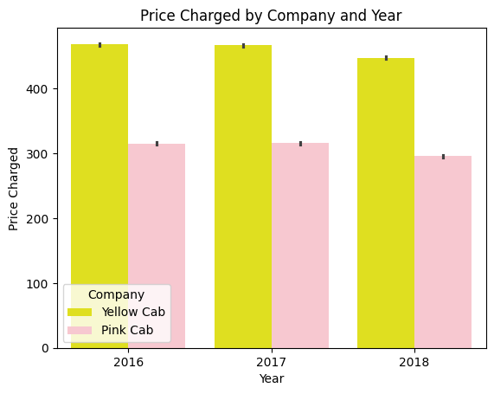
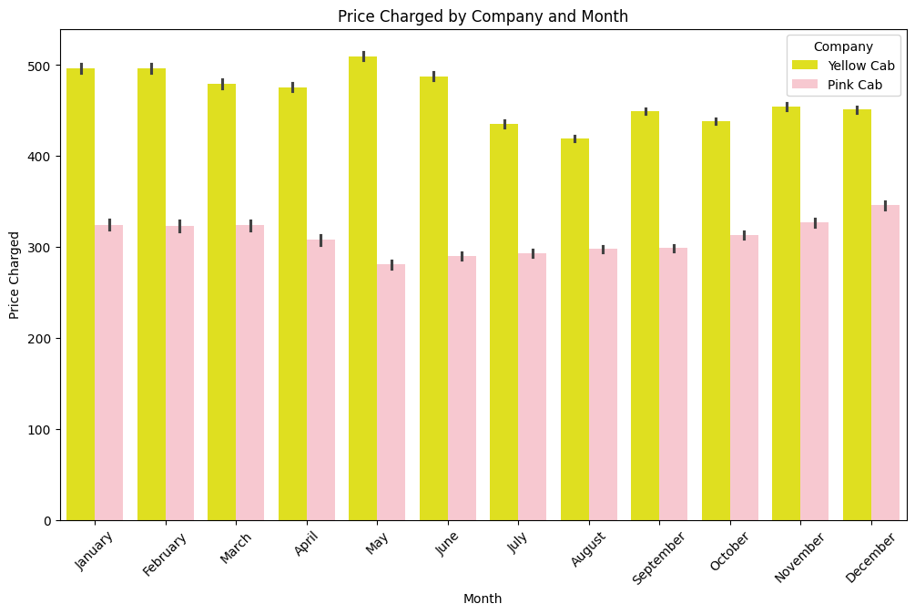
Analysis of Price Charged per Trip
Price charged by Yellow Cab is higher than the price charged by Pink Cab. While Yellow Cab is charging above $450 per trip, Pink Cab about $300.
Price charged by Yellow Cab is higher than the price charged by Pink Cab. While Yellow Cab charged a monthly average of about $450, Pink charged a monthly average of about $300

Slide 23
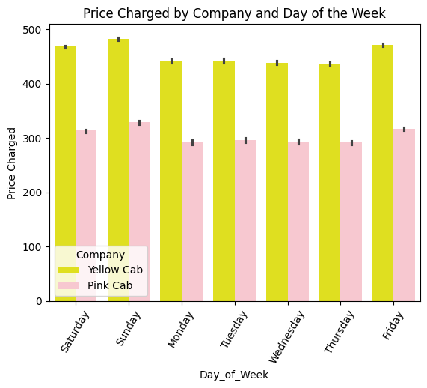
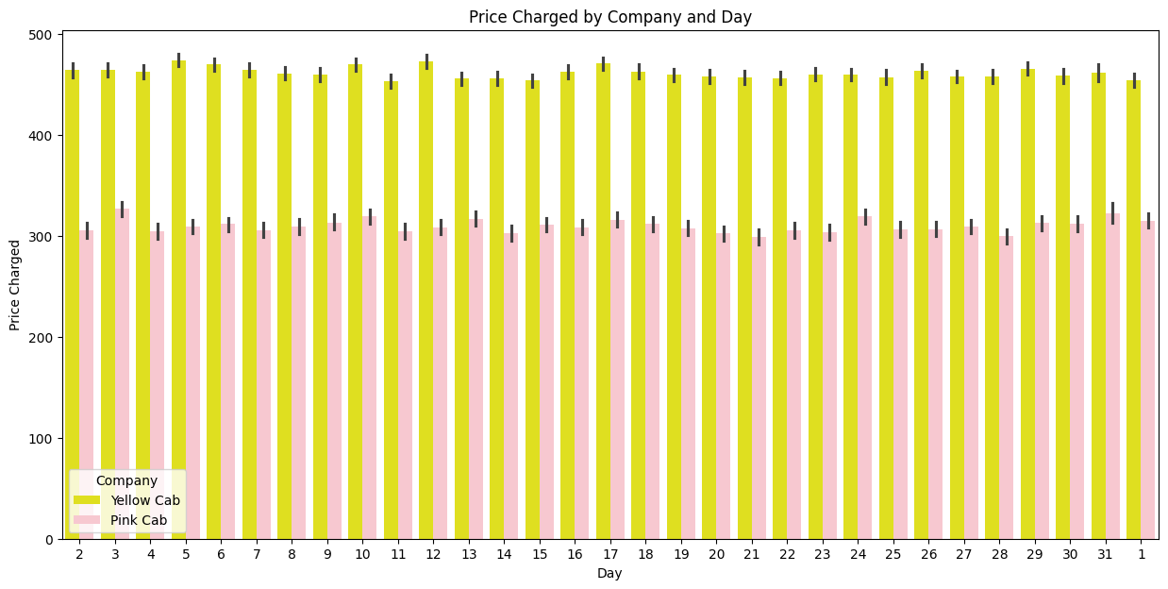
Analysis of Price Charged per Trip
Yellow Cab charges more than Pink Cab company every day of the week. While Yellow Cab charges an average above $450 per trip, Pink Cab charges $300.
Yellow Cab charges more than Pink Cab company every day of the month. While Yellow Cab charges an average above $450 per trip, Pink Cab charges an average slightly above $300

Slide 24
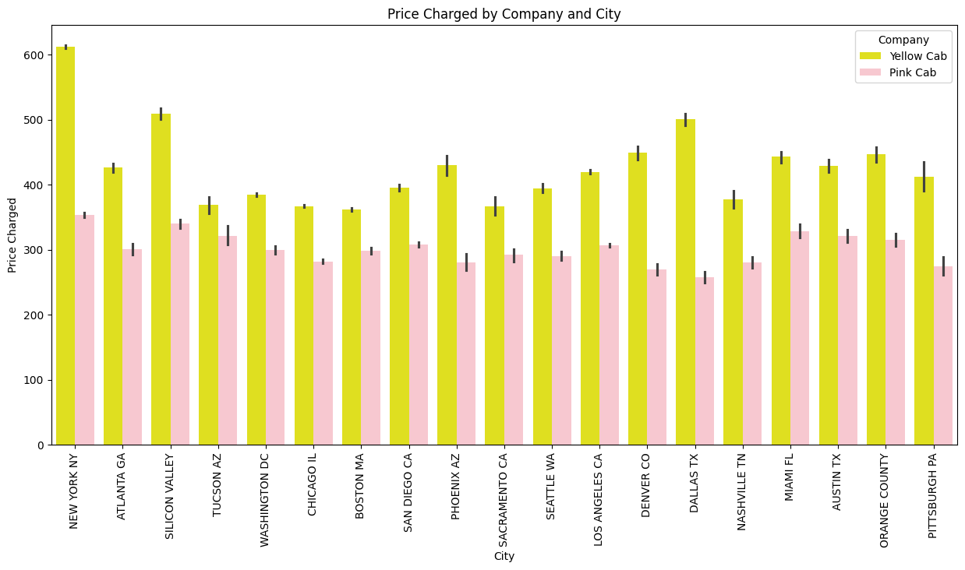
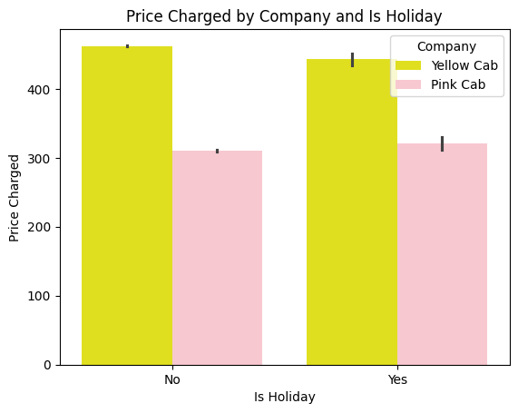
Analysis of Price Charged per Trip
Yellow Cab charges more (above $450) per trip than Pink Cab (about $300). Moreover, there seems to be no significant difference in price charge with or without holiday.
Yellow Cab charges more per trip than Pink Cab company in every city. Moreover, it is noticed that price charge by Yellow Cab varies by city with New York City, Silicon Valley, and Dallas being charged more.

Slide 25
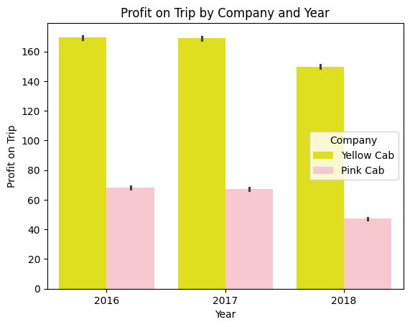
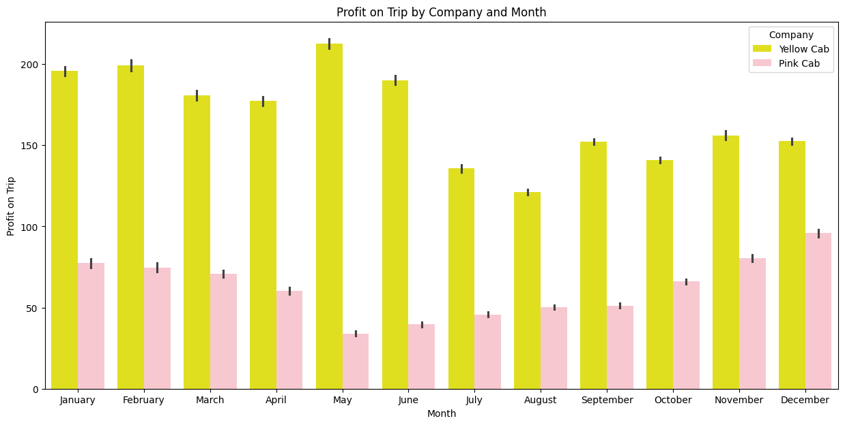
Analysis of Profit per Trip
Yellow Cab earns considerable higher profit than Pink Cab across the 3 years. While Yellow Cab was earning an average of about $160 on each trip Pink Cab was earning about $60 per trip.
Yellow Cab earns considerable higher profit than Pink Cab across the 3 years. While Yellow Cab was earning an average of about $160 on each trip Pink Cab was earning about $60 per trip.

Slide 26
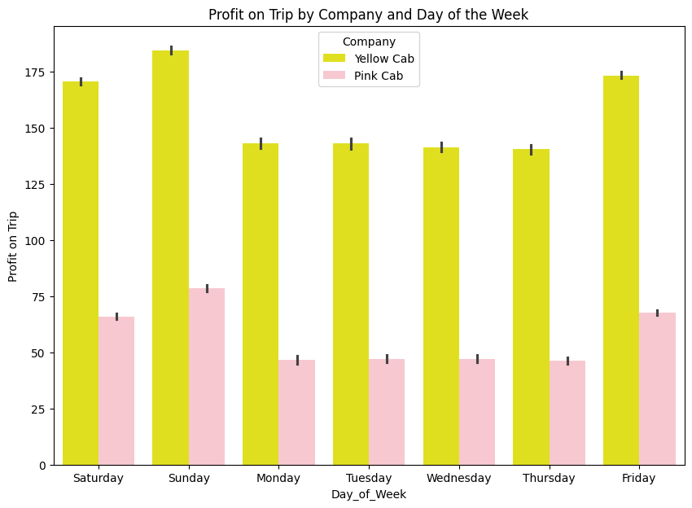
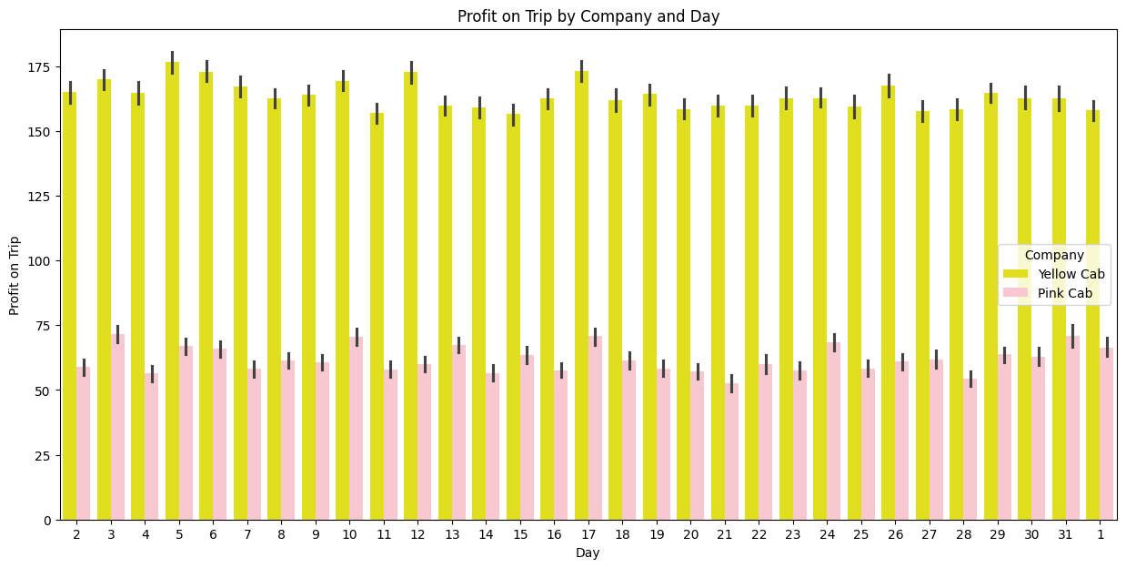
Analysis of Profit per Trip
Yellow Cab earns considerable higher profit than Pink Cab every day of the week and higher profit on Friday, Saturday and Sunday.
Yellow Cab earns considerable higher profit than Pink Cab every day of the month on each trip. While Yellow Cab was around $170 per trip, Pink Cab was earning about $70 per trip.

Slide 27
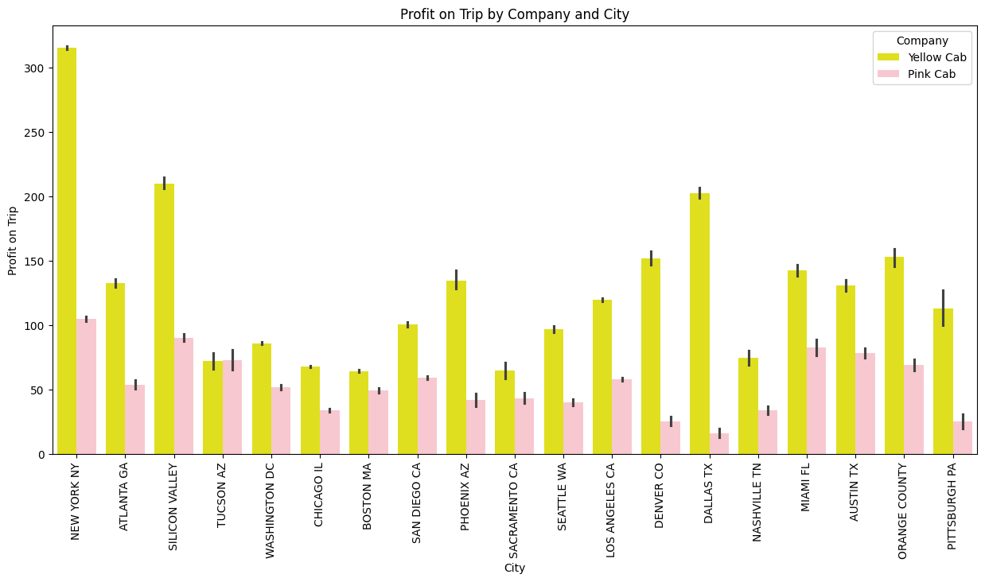
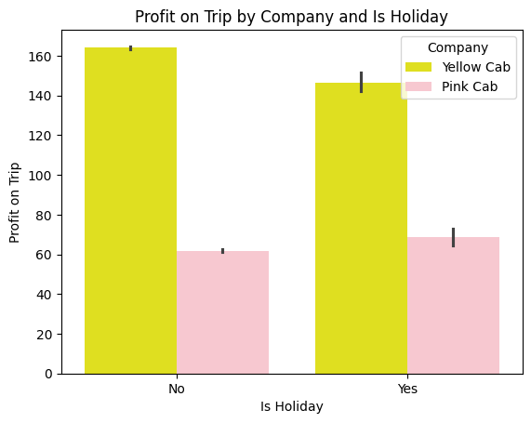
Analysis of Profit per Trip
Yellow Cab earns considerable higher profit than Pink Cab both on days with holiday and days without holiday.
Yellow Cab earns considerable higher profit than Pink Cab in every city and higher profit in New York, Silicon Valley and Dallas.

Slide 28
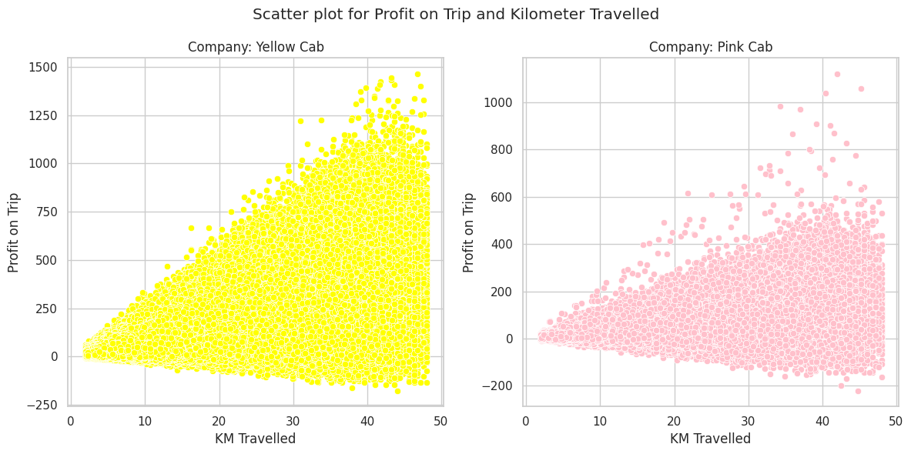
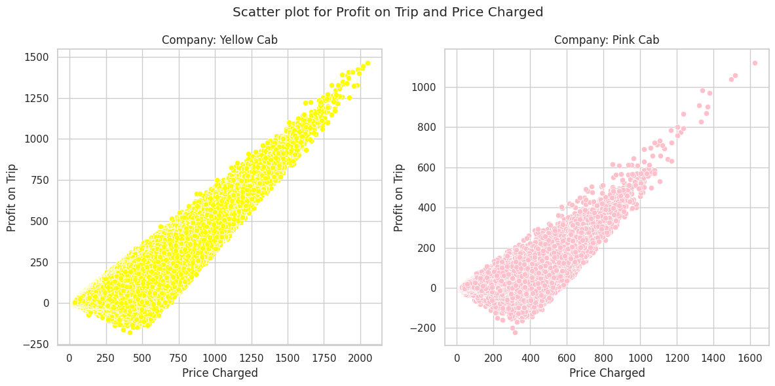
Relationship Between Performing Indicators
There is a relationship between distance travelled and profit earned. The more distance covered, the more the profit earned
There is a relationship between profit charged on trip and price charged. The higher the price charged, the higher the profit.

Slide 29
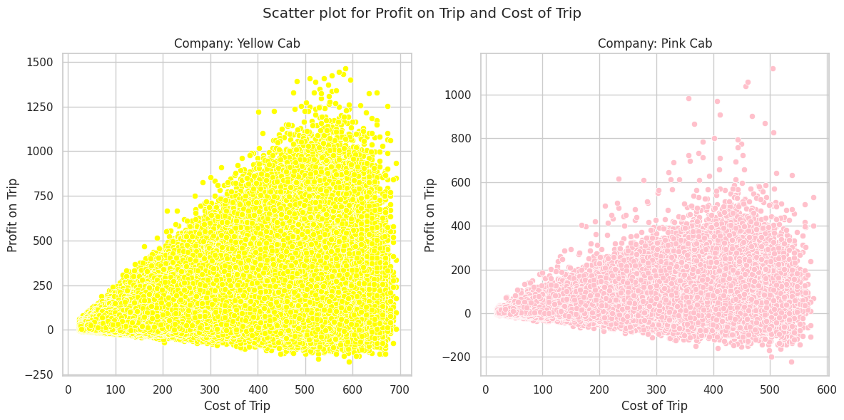
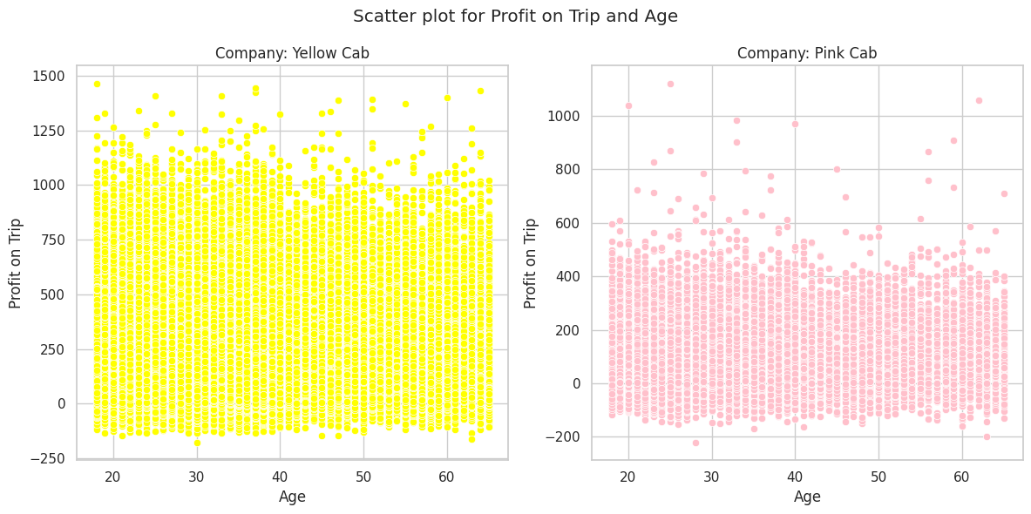
Relationship Between Performing Indicators
There is a relationship between cost of trip and profit on trip. The higher the cost of trip, the higher the profit made.
There is no relationship between Age of the customers and profit. That is, age does not in anyway impact profit

Slide 30
Hypothesis Testing
The hypothesis testing comparing Yellow Cab and Pink Cab revealed significant differences in variables such as Cost of Trip, Price Charged, Profit per KM, and Profit on Trip, with p-values of 0.0000, indicating statistical significance. However, no significant differences were found in variables such as KM Travelled, Income (USD/Month), and Age, with p-values of 0.7868, 0.4027, and 0.4692, respectively. These findings suggest distinct operational and financial performance metrics between the two cab companies.

Slide 31
EDA Summary
Profitability Trends: The analysis reveals distinct patterns in the profitability of Pink Cab and Yellow Cab companies. However, Yellow Cab outperforms Pink Cab across all metrics. Both companies exhibit higher profits in December, January, February, March, and April, but while Yellow Cab peaks in May, Pink Cab has the least profit.
Geographical Variations: Profits seem to vary significantly based on location, with certain cities such as New York and Silicon Valley yielding higher profits than others. Moreover, while Yellow Cab had considerably high profits in Dallas, Pink Cab had little profit.
Day and Time Analysis: Both companies experience higher profits on weekends (Friday to Sunday) and lower profits on weekdays. This is likely because people go out for fun more on the weekend.
Age and Income Influence: Insights into customer behavior based on age and income reveal that younger people between 18 and 25 years patronize more, and patronage decreases as age increases. Also, the middle class, those earning between $6,000 and $10,000, patronize cabs more, while the high class, those earning between $21,000 and $30,000, patronizes cab services the least.

Slide 32
Recommendations
Investment Consideration: Based on the insights gained from the analysis, Yellow Cab outperformed Pink Cab across all metrics. Therefore, it is highly recommended to consider investing in Yellow Cab.
Profit Sustainability Investigation: While Yellow Cab has shown relatively higher profits, it is crucial to note that the price charged per trip has been dropping, resulting in reduced profits over the years. It is recommended to investigate the reasons behind the decreasing prices, especially considering that the cost of the trip is not reducing. This investigation will provide insights into sustaining and potentially increasing profits.

Slide 33
Conclusion
Understanding the market dynamics is crucial for making informed investment decisions. The analysis suggests that Yellow Cab is a more profitable investment compared to Pink Cab. Additionally, investigating factors affecting profit sustainability will provide a comprehensive view for strategic decision-making

Slide 34
Thank You

